Slide 1
Quiz Answers
1. A: 611,658.554
2. B: 0.044
3.
4. A. 189
5. B: 3.80
6. C: Sean Miller
7. D: 9594
8. A: Furniture
9. B. Mark Van Huff
10. B: 21,122.8293

Slide 2
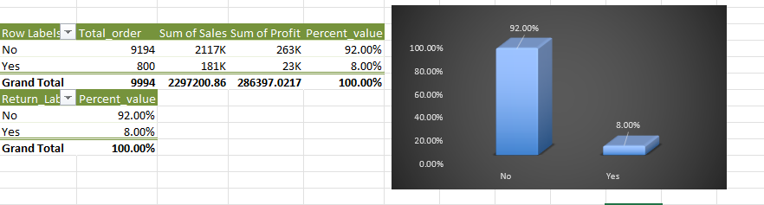
1. How many orders were returned, and what percentage of total orders does this represent and Calculate the total loss due to returns in terms of both sales revenue and profit.
800 orders were returned.
8 % of total orders were returned.
For both the Return Status, calculated
total profit made in both situations and total
Sales done in both condition.
After that, calculated total loss in sales and
decline in profit.

Slide 3
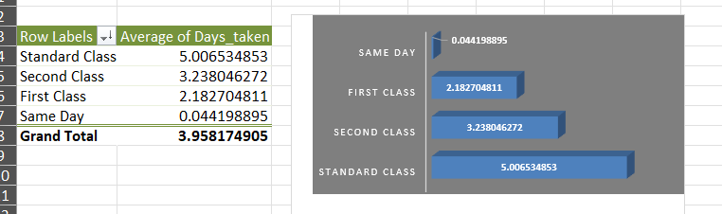
2. Analyse the average time it takes for orders to be shipped (Ship Date - Order Date) for each shipping mode and Identify which shipping mode has the fastest and slowest delivery times.
Standard Class has Maximum shipping time of 7 days.
Same Day class has Minimum Shipping time of 1 day.
Average Shipping time is 3.95 Days.
Maximum and minimum shipping time is calculated using Pivot Function.
Average is calculated using Table feature and verified using Pivot function.

Slide 4
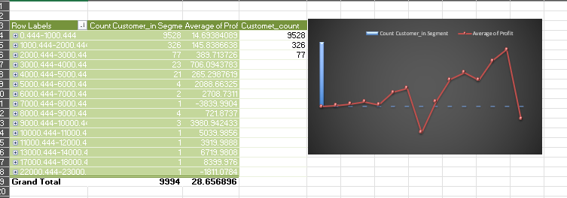
3. Segment customers based on their purchasing behaviour (e.g., total sales, frequency of orders) and Analyse the profitability of each customer segment and identify the most valuable segments.
Segmented Customers on the basis of monthly average profit.

Slide 5
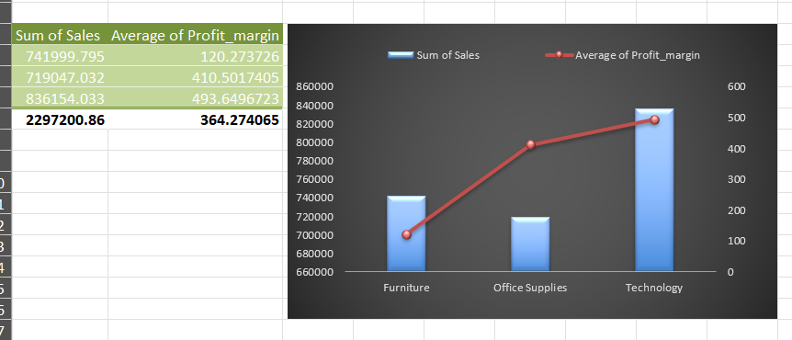
4. Determine the top-selling product categories and sub-categories based on total sales and Calculate the average profit margin for each product category and sub-category
Top Selling Product Category: Technology
Top Selling subcategory in Technology: Phones
Top Selling subcategory in Furniture: Chairs
Top Selling subcategory in Office Supplies: Storage
Did all the calculation using Pivot function.
Sorted the product categories and subcategories based on Sales only.
Calculated Average of Profit for all categories and subcategories.

Slide 6
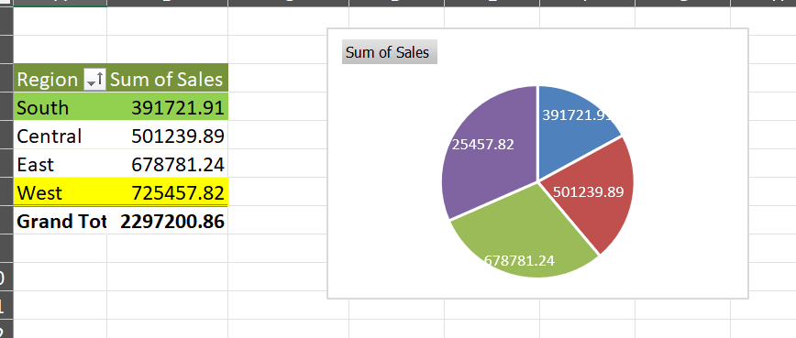
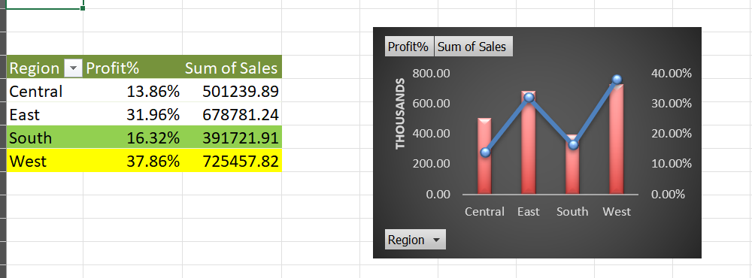
5. Compare sales performance across different regions and identify regions with the highest and lowest sales and Analyse the profitability of orders in each region and determine if there are any regional trends affecting profitability.
West has highest number of sales whereas South has the least.
Plotted a pivot chart to display distribution of Sales among all the regions of United States.
To find the Trend in Sales, Plotted a Compo pivot chart showcasing the Trend of Sales in all the regions pf United States.

Slide 7
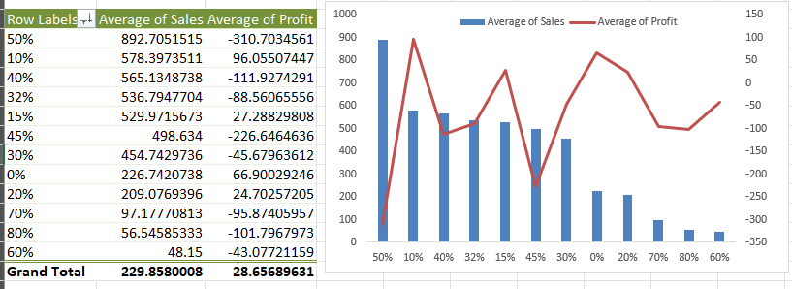
6. Investigate the impact of discounts on sales and profitability and Calculate the correlation between the discount rate and the quantity sold, as well as the discount rate and profit margin.
Correlation between discount rate and quantity sold
=CORREL(Superstore_Table[Discount],Superstore_Table[Quantity])
0.00862297
Correlation between discount rate and profit margin
=CORREL(Superstore_Table[Discount],Superstore_Table[Profit])
-0.2194875

Slide 8
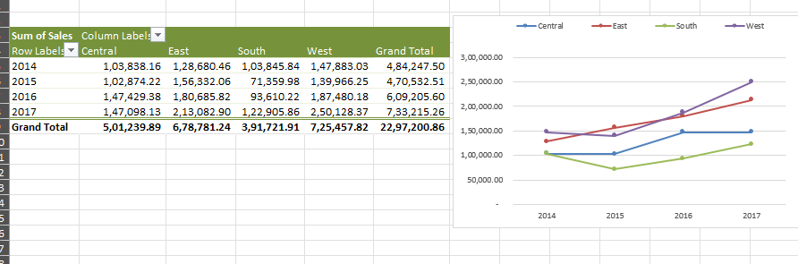
7. : Identify potential new markets for expansion based on regions with low market saturation and high growth potential and Develop a strategy to penetrate these new markets and increase market share.

Slide 9
8. : Determine the customer retention rate by analysing repeat orders from existing customers and Develop strategies to improve customer retention and increase customer lifetime value.

